Slide 1
MARKETING ANALYTICS Group Project

Slide 2




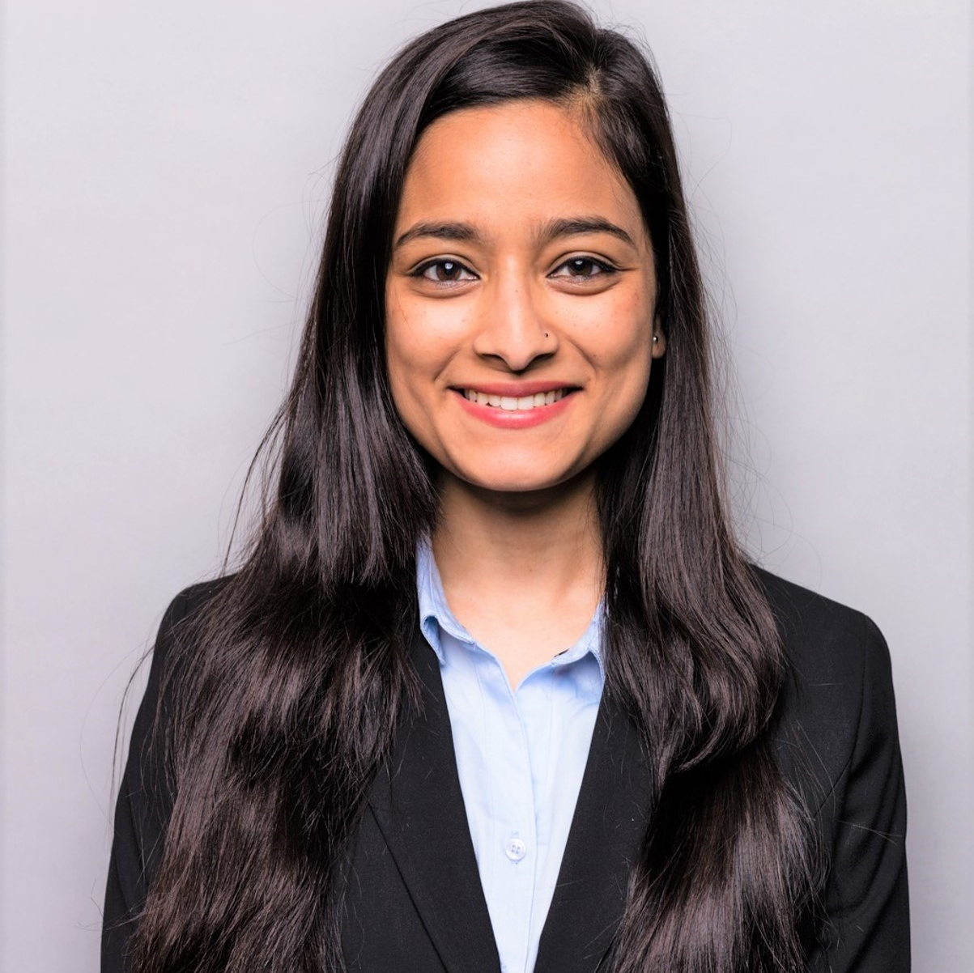
MEET THE TEAM
Amal Tom
Chethan Manjunath
Kamalika Das
Pratik Kamat
Sarnav Chauhan

Slide 3
AGENDA
PROJECT DESCRIPTION
BUSINESS PROBLEM
DATA UNDERSTANDING
ANALYSIS & INSIGHTS
CONCLUSION
APPENDIX

Slide 4

iFood
A Brazilian food ordering and delivering platform

Slide 5
Business Objective
To understand the characteristic features of customers, their purchase behaviour and the impact of iFood’s marketing activities

Slide 6
PROCESS FLOW
Understanding the company
Analyzing purchase behavior
Recommendations
Understanding iFood’s current state and the different customer characteristics and its effect on sales
Identifying factors impacting sales and campaign effectiveness. Segmenting customers based on purchase behavior to target effectively and identifying best product combinations.
On the basis of our analysis, we will propose some suggestions for the company to maximize profit of the campaign.

Slide 7
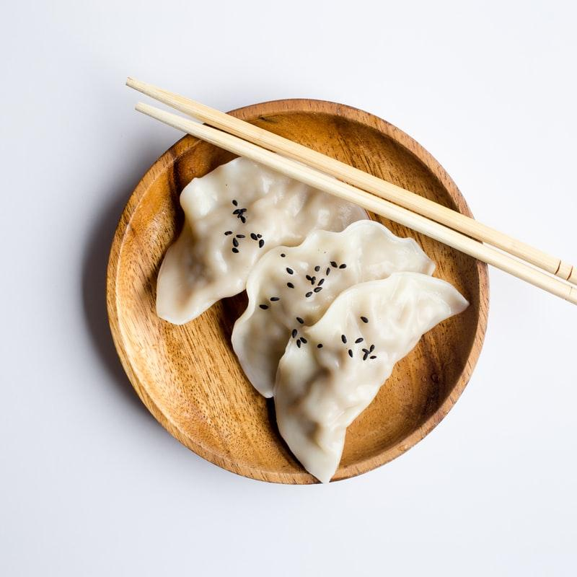




DATA OVERVIEW
DATA OVERVIEW
Customer Level Data
2205 Records
Demographic Information
Age, Education, Income, Marital Status, Kids
Transaction Information
Amount Spent across Food Categories,
Instore and online purchases
Marketing Activity Information
Campaign acceptances

Slide 8





ABOUT CUSTOMERS
Average Income
$52K
Average Age
51 years
Education
89% College Graduate and above
Family
42% have young kids
Marital Status
65% have partners

Slide 9
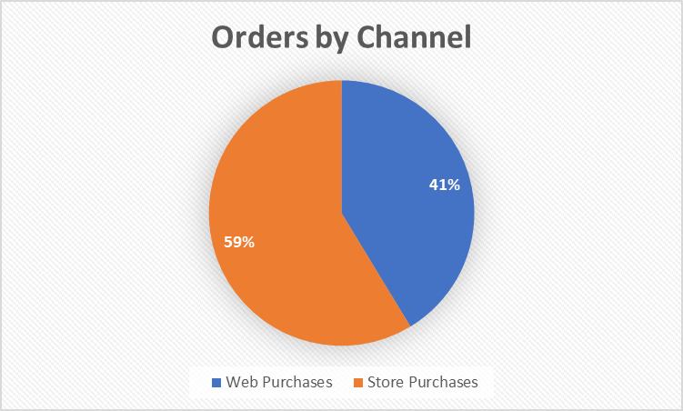
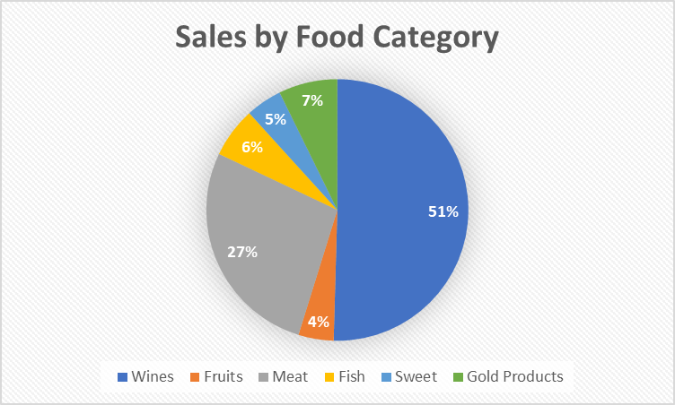
CURRENT BUSINESS SCENARIO
Observations:
Volume of the store purchases is more than 1.4 times that of web purchases
Wine is the most preferred item

Slide 10
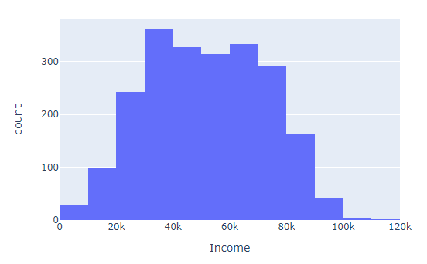
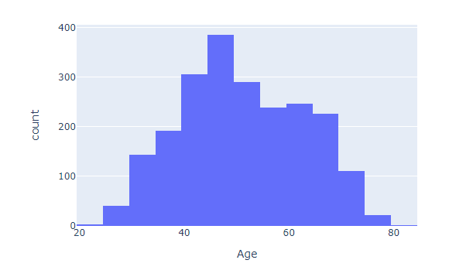
EXPLORING CUSTOMER CHARACTERISTICS
CURRENT SCENARIO
Age
Income
Most customers are between the age of 50-55
Most customers have income between 40k to 70k per annum

Slide 11
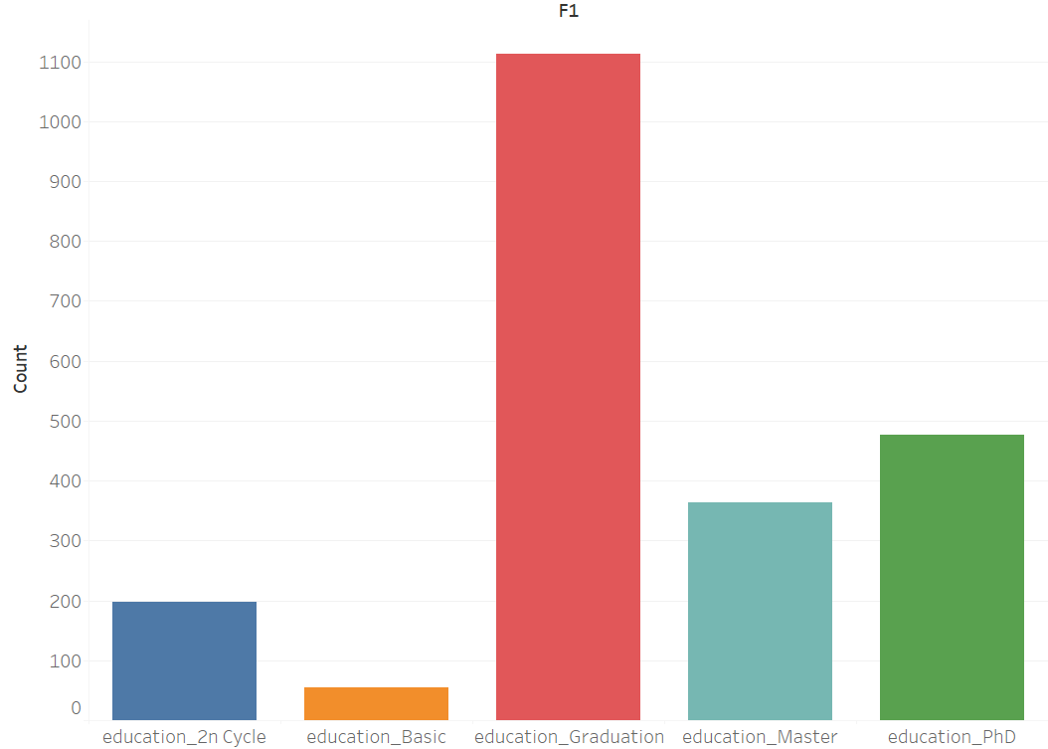
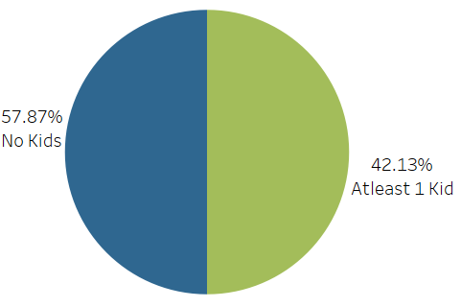
EXPLORING CUSTOMER CHARACTERISTICS
CURRENT SCENARIO
Most of customers are graduated
Majority of customers don’t have children

Slide 12
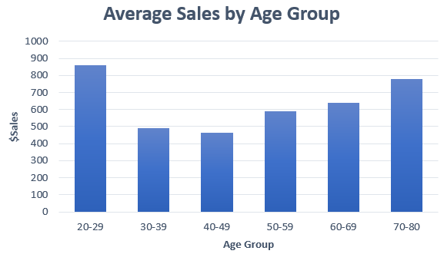
CUSTOMER PURCHASE BEHAVIOR
PURCHASE BEHAVIOR - I
On conducting a hypothesis testing:
H0: Sales are not impacted by age of customer
H1: Sales are impacted by age of customer
We get a p-value of 2.48e-08, which means we have enough statistical evidence to reject the null hypothesis and conclude that sales are impacted by age
As age increases, there is an initial drop in sales followed by a rise

Slide 13
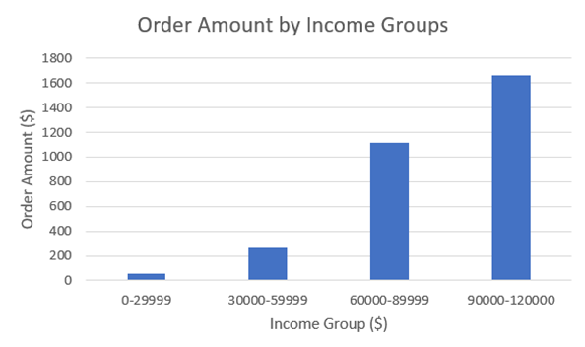
CUSTOMER PURCHASE BEHAVIOR
PURCHASE BEHAVIOR - II
On conducting a hypothesis testing:
H0: Sales are not impacted by income of customer
H1: Sales are impacted by income of customer
We get a p-value < 2e-16, which means we have enough statistical evidence to reject the null hypothesis and conclude that sales are impacted by income
Customers with higher income tend to order for more amount

Slide 14
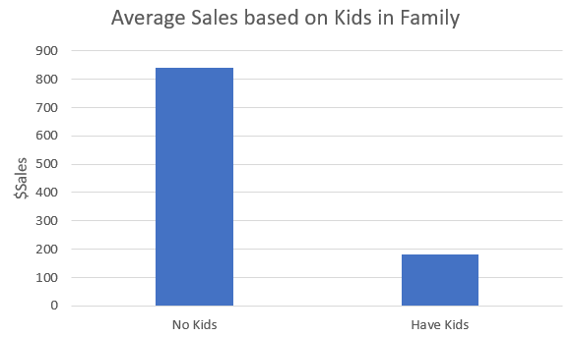
CUSTOMER PURCHASE BEHAVIOR
PURCHASE BEHAVIOR - III
On conducting a hypothesis testing:
H0: Customers without kids do not spend more than customers with kids
H1: Customers without kids spend more than customers with kids
We get a p-value < 2e-16, which means we have enough statistical evidence to reject the null hypothesis and conclude that customer without kids spend more than customers with kids
Customers without kids order for 4.7 times the amount as ones with kids

Slide 15
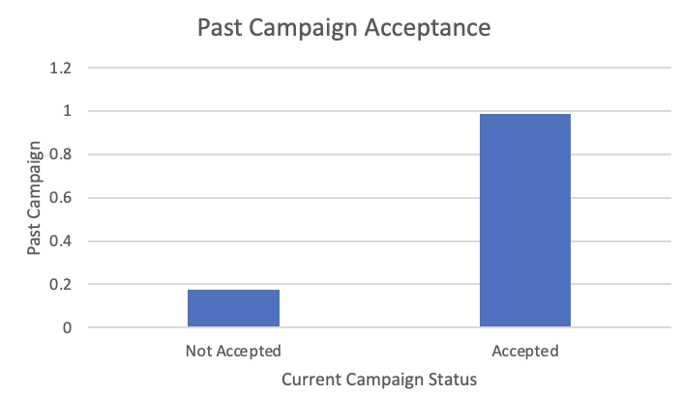
FACTORS AFFECTING CAMPAIGN EFFECTIVENESS
Identifying factors impacting customers’ propensity to accept a campaign:
Model: Random Forest Classifier
Major Factors Identified: Recency of Purchase, Past campaign acceptance, Customer Lifetime
On average, the customers who accepted campaigns in the past also showed tendency of accepting the current campaign.

Slide 16
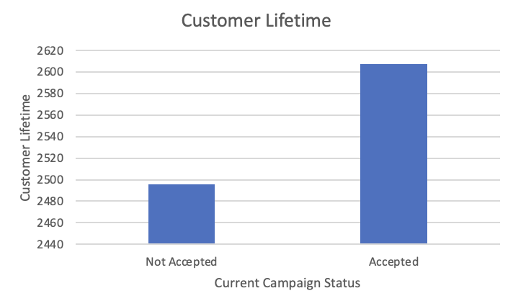
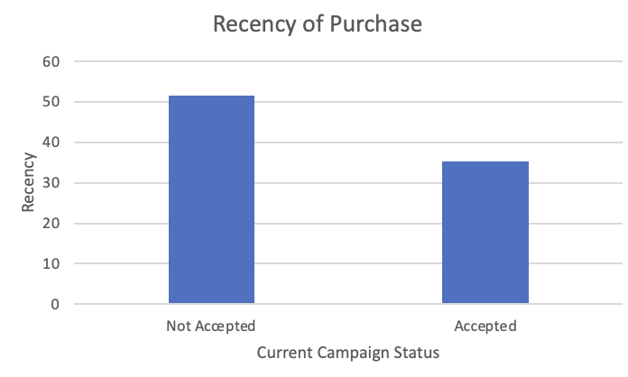
FACTORS AFFECTING CAMPAIGN EFFECTIVENESS
Customers who accepted the campaign have higher customer lifetime.
Campaign acceptance higher with customers who have made a more recent purchase.

Slide 17
CUSTOMER SEGMENTS
4 Customer segments were created using K-means on customer’s Order Recency, Frequency and Amount Spent
Understanding the demographics and purchase behaviors of these segments will help iFood target them better.
Segment | Recency of Orders | Frequency of Orders | Order Amount
A | Recent | Low | Low
B | Recent | High | High
C | Not Recent | High | High
D | Not Recent | Low | Low

Slide 18

SEGMENT A
Digital David
Order Recency : Recent
Order Frequency : Low
Customer Spend : Low
Recommendations
Promote on websites
Promotions based on minimum spend condition:
Ex – 15% off for orders above $100
Relatively younger
Relatively Low Income
Visits website frequently
Likely married

Slide 19

SEGMENT B
Ideal Iris
Order Recency : Recent
Order Frequency : High
Customer Spend : High
Recommendations
Send catalogues with discounts via post
Promotions focussed on Wines (Older customers have a higher spend on wine)
Relatively High Income
Use Catalogues frequently
Higher propensity to accept discounts
Relatively less educated

Slide 20

SEGMENT C
Rich Rose
Order Recency : Not Recent
Order Frequency : High
Customer Spend : High
Recommendations
Send catalogues with discounts via post
Promotions focussed on Wines (Older customers have a higher spend on wine)
Offer loyalty points to incentivise them to buy often
Relatively older
Relatively High Income
Use Catalogues frequently
Higher propensity to accept discounts

Slide 21

SEGMENT D
Non-committer Nick
Order Recency : Not Recent
Order Frequency : Low
Customer Spend : Low
Recommendations
Less emphasis on such customers
Relatively Low Income
Visits websites frequently
Less affinity towards promotions

Slide 22


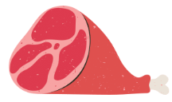


0.966, 0.994, 1.00
0.966, 0.972, 1.00
Association Rule Insights
Support: This is the measure of the frequency with which a particular item or combination of items appears in transactions.
0.817, 0.822, 0.993
0.971, 0.999, 0.971
0.821, 0.822, 1.00
0.993, 1.00, 1.00
0.821, 1.00, 1.00
0.993, 0.994, 0.999
Confidence: This is the measure of the likelihood that one item will be purchased if another item has already been purchased.
0.971, 0.972, 0.99
Lift: This is the ratio of the observed support for a combination of items to the expected support if the items were purchased independently.
0.827, 0.999, 1.00
0.827, 0.828, 1.00
0.735, 0.895, 1.08

Slide 23

Recommendations
In future campaigns, focus on customers with a high customer lifetime, made recent purchases and who have accepted campaigns before
Implement customer segment-based promotions to target these segments effectively
Products of having a high probability of being purchased together should be placed together in stores (or recommended on websites)

Slide 24


